Slide 1
SPADE
SEIZURE PREDICTION AND DETECTION ENGINE
UNDER THE MENTORSHIP OF: Dr SHALINI BATRA
SUBMITTED BY:
AMAN KUMAR 401503006
KESHAV GARG 401503013
KUNAL KISHORE 401503014
SOPHIE KAKKER 401503029

Slide 2
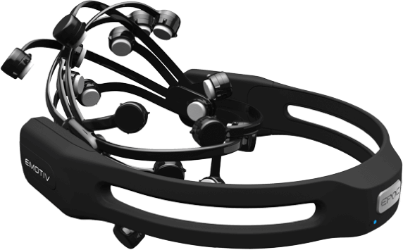
PROBLEM DEFINITION
Epilepsy is the 4th most common neurological problem.
1/3rd of patients with epilepsy continue to have seizures despite optimal medication management.
Some of the difficulties in managing treatment of epilepsy can be reduced by the ability to detect clinical seizures.
The capability of early detection of seizures and prediction systems might be able to abort seizures through targeted therapies. Such systems would also be able to prevent accidents and limit injury.

Slide 3
PROJECT OUTCOME
Desktop app to train the model for seizure prediction
Highly customisable
Will give weights that will be further used in the mobile application.
An App is made which acts as an interface to the headset and performs the following tasks:
Linking to the server database for downloading the weights of the model.
Predict the seizure by running model simultaneously with the input.
Sends message and makes a phone call to the emergency contact.
Alert the user by sending a notification .

Slide 4
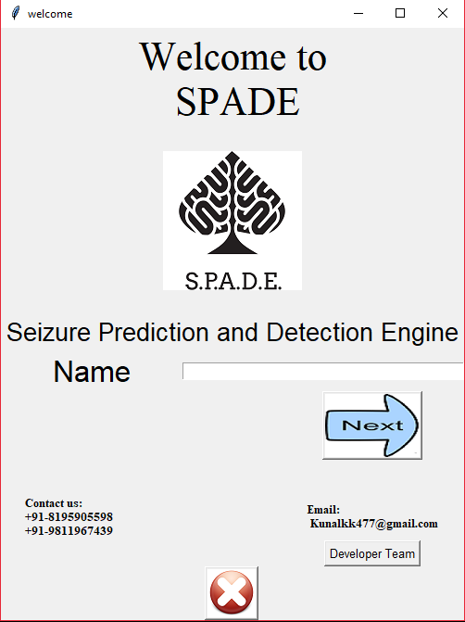
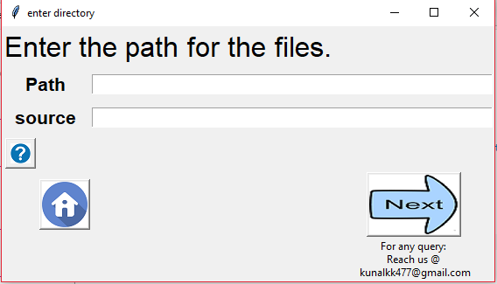
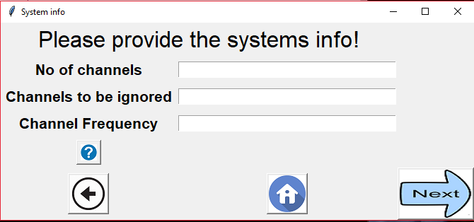
Desktop app

Slide 5
Mobile Application

Slide 6
OBJECTIVES
To develop a non-invasive seizure prediction methodology to improve the quality of life of the patients with epilepsy.
To accurately classify preictal and interictal brain state in humans with naturally occurring epilepsy.
To predict the onset of a seizure and warn the patient and alarm the nearby medical services for emergency assistance.

Slide 7
NEED ANALYSIS
Epilepsy afflicts nearly 1% of the world's population and is characterised by recurrent and sudden seizures.
For many patients, anticonvulsant medications can be given at sufficiently high doses to prevent seizures, but patients frequently suffer side effects.
If seizures can be detected beforehand, then patients could avoid potentially dangerous activities like driving or swimming.
medications could be administered only when needed to prevent impending seizures, reducing overall side effects.

Slide 8
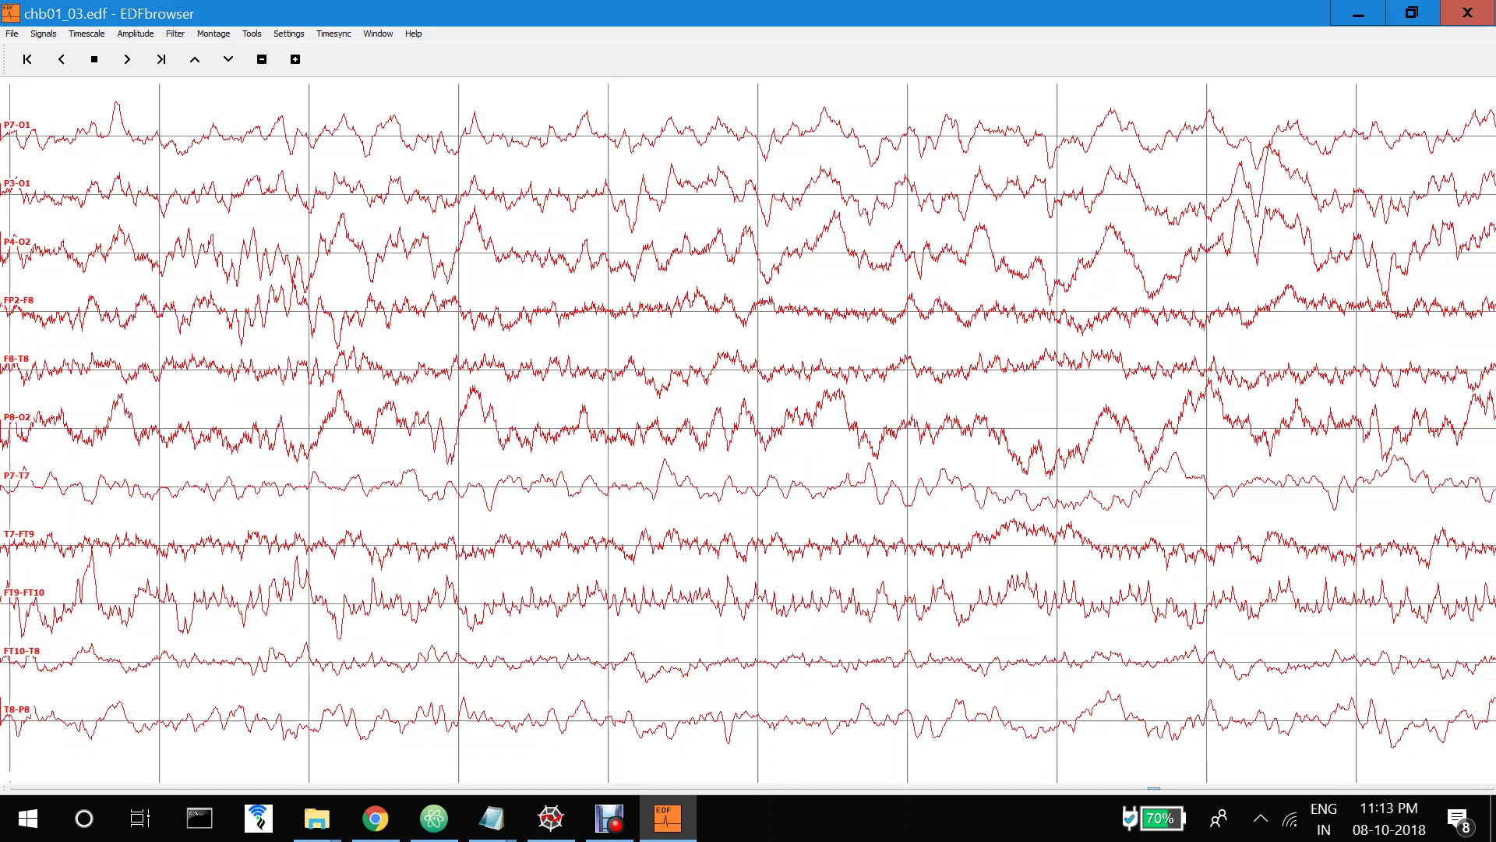
BEFORE EPILEPSY

Slide 9
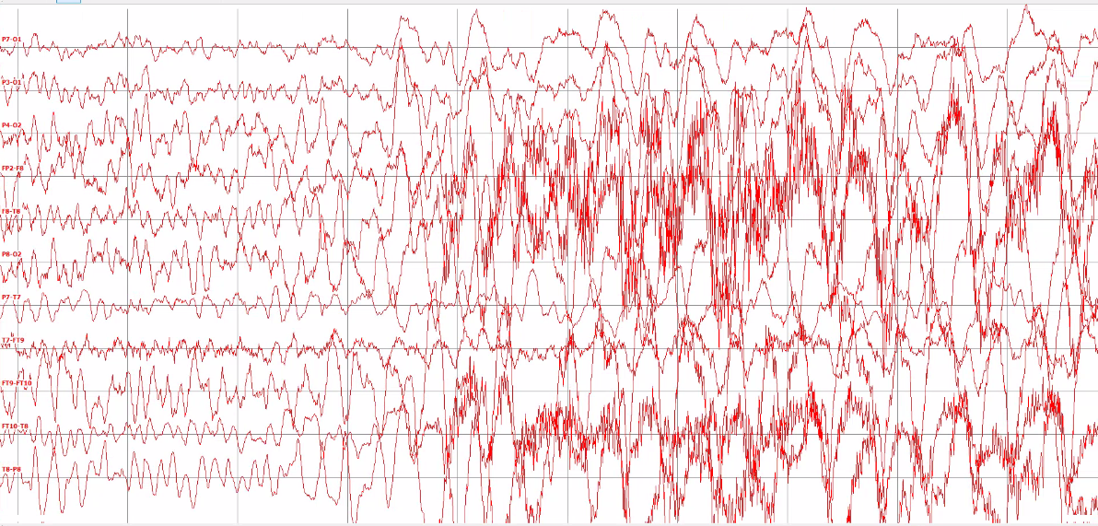
Starting of a seizure

Slide 10
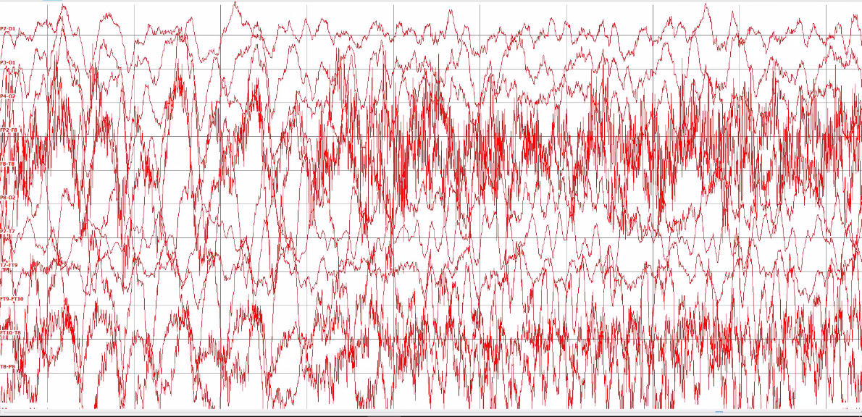
DURING EPILEPSY

Slide 11
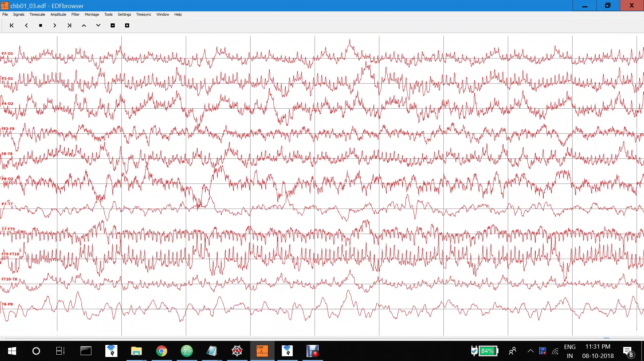
AFTER EPILEPSY

Slide 12
Live demonstration..

Slide 13
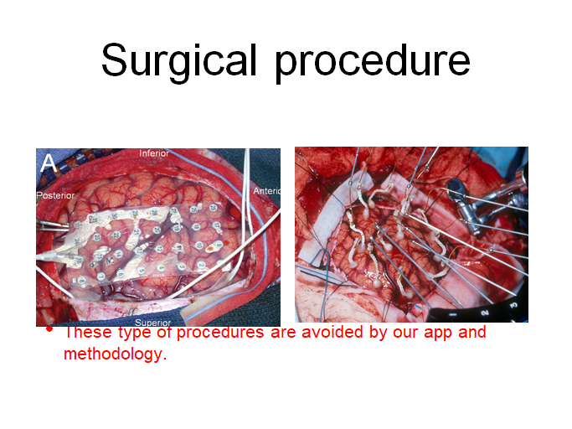
Prevention and Benefits

Slide 14
literature survey
Signal pre-processing – Domains, CSP algorithm
Feature extraction – PSD, entropy, Hurst exponent, Largest Lyapunov exponent, correlation dimension, kurtosis
Feature selection – Univariate and multivariate algorithms, PCA
Machine learning model optimisation – Experimentation with Deep learning

Slide 15
COST ANALYSIS
Headset cost = 12,000/-
Cost to us = 0/-
(as is provided by one of the faculties of TIET)
Cost of software used=0/-
Hence, Total cost to us is ZERO

Slide 16
ROLE OF INDIVIDUAL TEAM MEMBER

Slide 17
CURRENT PROGRESS

Slide 18
FUTURE WORK PLAN
A methodology or technique could be developed such that we require much less seizure data to train the machine learning model
Recent research in the field of deep learning techniques such as transfer learning and reinforcement learning holds immense possibility of a much less time consuming and less tiresome algorithm which can train and improve the model in real-time
A standalone product could be engineered which is much more comfortable, light weight and easy to wear
An app that will be able to communicate much further and predict the epilepsy even before an hour of the seizures.
To able to provide the exact location of the patient to the emergency contact in case of a sudden epilepsy.

Slide 19
THANK YOU

